Slide 1
TRANSFER CAR GUIDANCE
AND SAFE WORKING PRACTICES

Slide 2
Guidance Content
Contents Slide Number
Transfer car definition 3
Transfer car hazards and hazard areas 4
Hazardous scenarios 5
Elimination 6
Prevent access to the transfer car 7 - 11
Prevent contact with the transfer car - proximity lasers 12 -19
Prevent contact with the transfer car - proximity alert systems 20 - 23
Control access to the transfer car lane 24
Sound and visual warning 25 - 27
Crossing points 28 - 33
Identification of the transfer car routes 34
Floor markings / Signage 35 - 36
Conveyor layout 37 - 40
Elimination of conveyor entrapment points 41 - 43
Minimising conveyor shear points 44
Safe distances and minimum gaps 45 - 48
Other general control measures 49 - 51
Appendices 52 - 53

Slide 3
Transfer Car Definition
DEFINITION
Transfer cars are moveable cars with installed manual or power - driven conveyors for the transportation of material units. These material units are transferred from continuous conveyors, are moved laterally and discharged to another continuous conveyor of another machine or conveyor.
Transfer cars can reach speeds up to 180 m/min with large stopping distances and can be fully automatic or manually driven by operators.

Slide 4
Transfer Car Hazards and Hazard Areas
Injuries from contact with moving transfer cars
Struck by moving transfer car
Struck by moving transfer car due to malfunction of control system (unexpected start up, unexpected overrun)
Trapped between transfer car and conveyor lines.
Crushed between transfer car and a fixed structure / object
Trapped / crushed between transfer car and a falling load.
Impact from transfer car and other vehicles e.g. FLT
Potential hazard areas
Transfer car lanes / cells
Cross over passageways
Transfer car WIP areas
Transfer car maintenance areas

Slide 5
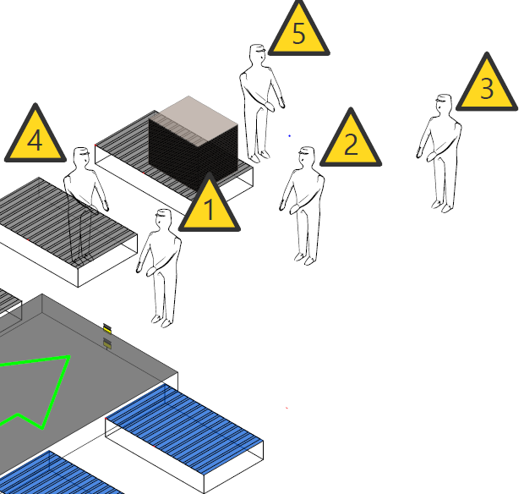
Hazardous Scenarios
Person in the path / route within the stopping distance of the transfer car.
Person in the path / route just outside the stopping distance of the transfer car.
Person in the path / route currently undetected.
Person close to the path / route.
Person “hidden” behind a stack of corrugated board.

Slide 6
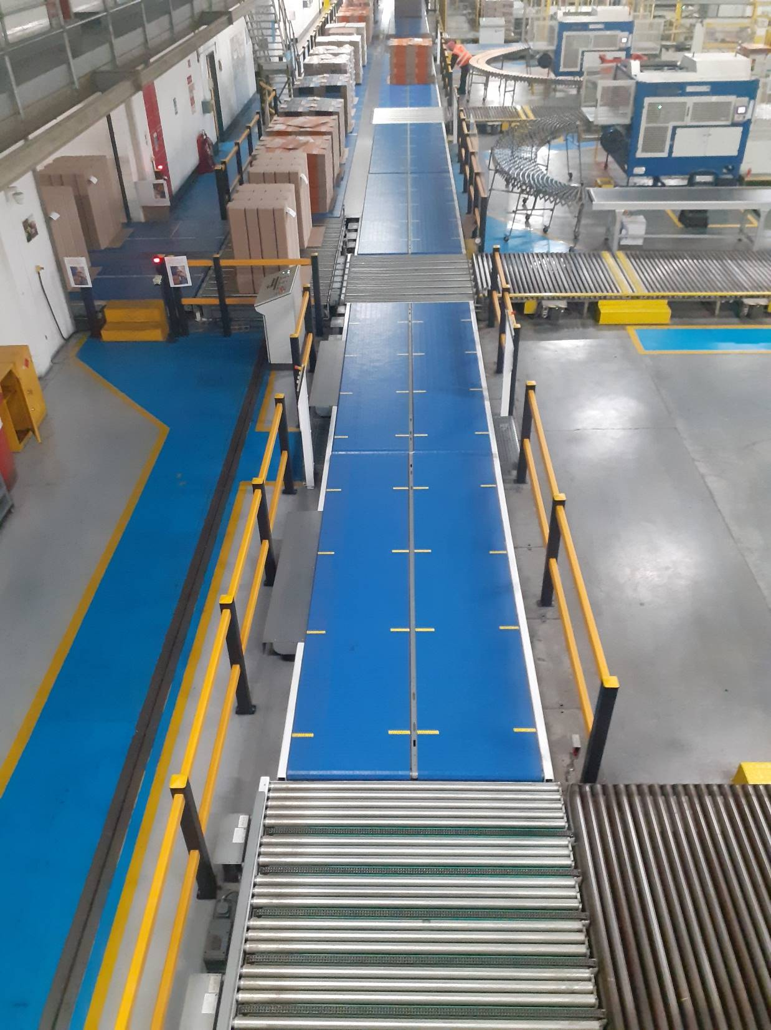
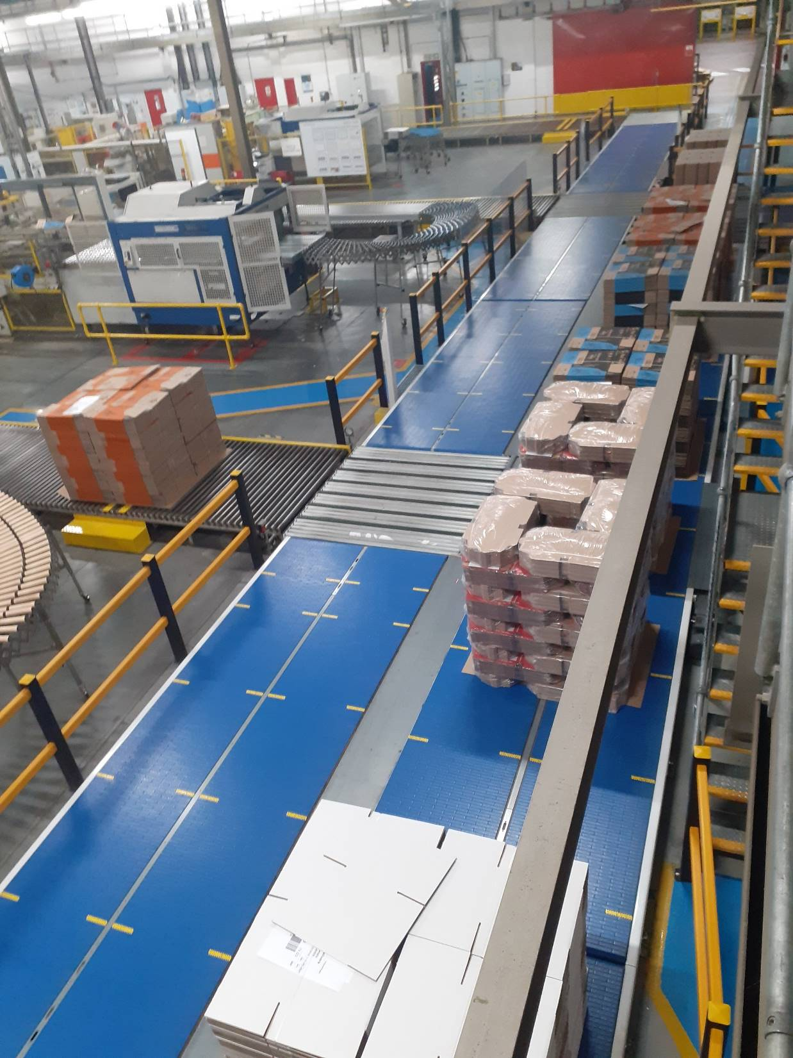
Elimination – TC1
Eliminate transfer car use and replace with mechanical / conveyor systems

Slide 7
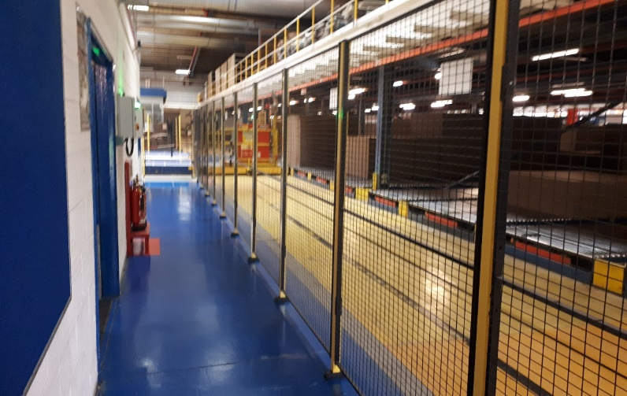
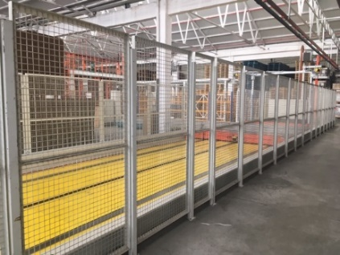
Prevent access to the transfer car – TC 2
Physical enclosure
Physical enclosure of the transfer car route
Install a combination of fixed guarding / safety system to protect the restricted area with controlled gated entry – control philosophy in place to ensure that the transfer car cannot operate whilst there is activity / presence in the car cell.
Height of the fence to a minimum of 1400mm from the floor. The gap between the floor to the bottom of the fence should be no more than 180mm.
Reach distances to the hazard should be considered using the BS EN 13857 standard (upper and lower limb reach distances).

Slide 8
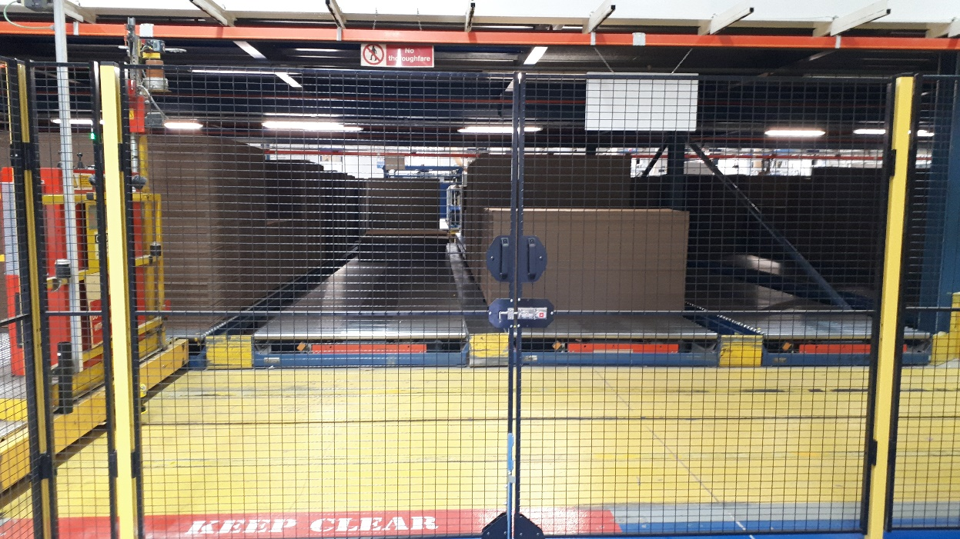
Prevent access to the transfer car – TC 3
Controlled gated entry / Key Exchange
Principle of key exchange is one key per person and that person exchanges the key with a second key from the gate. The person holds on to the key during entry. This is for lane entry, not for maintenance tasks on the transfer car.
Example - There are 3 different lettered keys:-
A = Master key – Will only fit into side of control panel and releases keys B.
B = Gate release key – To be removed from control panel and inserted into safety gates to release key
C = Person retain key – To be kept on person at all times whilst inside the guarded area.

Slide 9
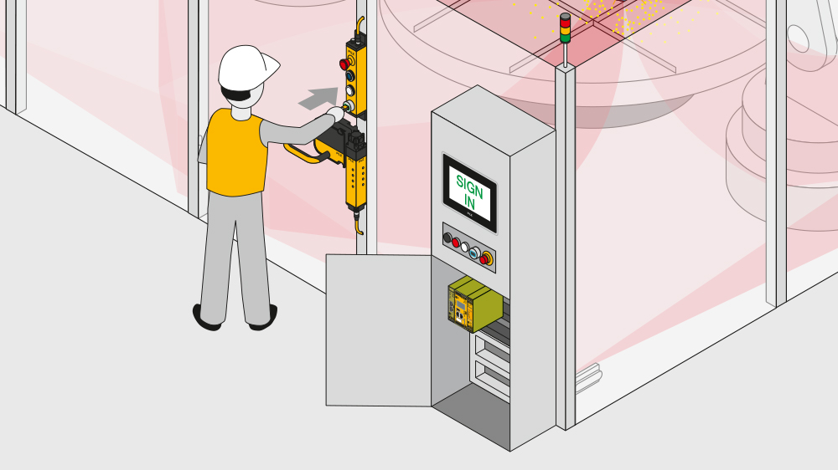
Prevent access to the transfer car – TC 4
Key-in-pocket (initial situation)
Dangerous area (transfer car) protected by e.g. a metal fence.
If an operator needs to enter the area, the machine must shutdown.
When the machine has been shut down, the person can go inside and do their work.
As long as persons are in the dangerous zone, the machine must not be switched on again by anyone.

Slide 10
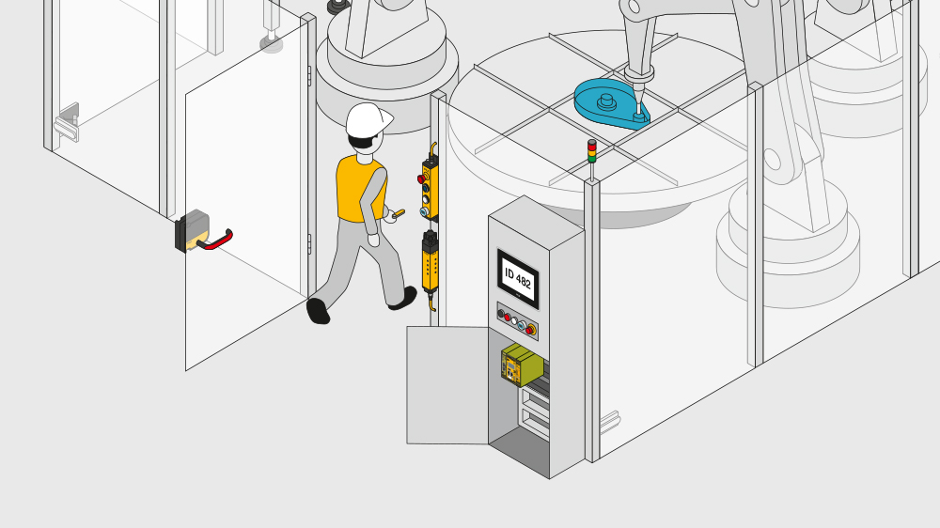

Prevent access to the transfer car – TC 5
Key-in-pocket (solution approach)
An operator must authenticate himself (sign in) with his personal transponder key at the (cell) door.
If the operator is authenticated, he can shut down the machine and open the door, remove the key and enter the facility. Other operators can also sign in with their personal key and enter the facility.
Only when all signed in operators left the facility and signed out with their personal key, the machine can subsequently be started.

Slide 11
Prevent access to the transfer car – TC 6
Key-in-pocket (Safety Function)
  Identification of persons and
  protection against accidental (machine) start-up
  as long as at least one user is signed in.
PL d Cat. 3 according to EN ISO 13849-1
SIL CL 2 according to EN 62061
SIL 2 according to IEC 61508

Slide 12
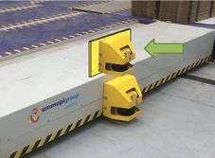
Prevent contact with the transfer car – TC 7
Proximity Lasers
Front Safety Proximity Laser
Rear Safety Proximity Laser
Over / Under scanning
Where scanning underneath of the conveyor is not possible because the conveyors are completely covered, this area has to be safeguarded by a second laser scanner

Slide 13
Prevent contact with the transfer car - TC 8
Proximity Lasers
On the front and rear of the transfer car where safety proximity lasers have been installed. These lasers are designed to slow down and stop the transfer car if there are people or objects in front of it. Even though the laser scans for objects, you still need to be aware of its limitations.

Slide 14
Prevent contact with the transfer car - TC 9
Proximity Lasers
Protection by optoelectronic detection; stops the transfer at a predetermined set distance
Second laser scanner
Scanning above the conveyor if a safeguarding of the movement of the transfer car is secured by a laser scanner.
This scanner has to scan the area above the conveyor by at least 100 mm.

Slide 15
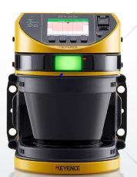
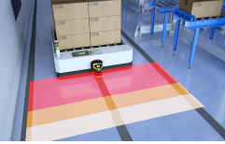
Prevent contact with the hazard - TC 10
Proximity Lasers
Instructions – Setting on Lasers
The installation of the scanners and the evaluation of the electronics must fulfil the requirements of PL d of ISO 13849-1:2015.

Slide 16
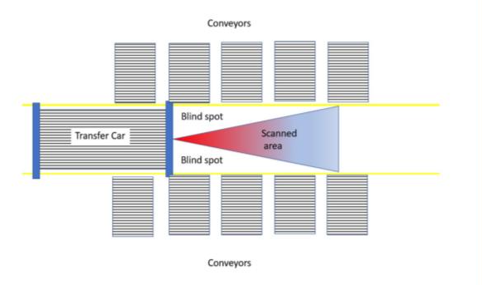
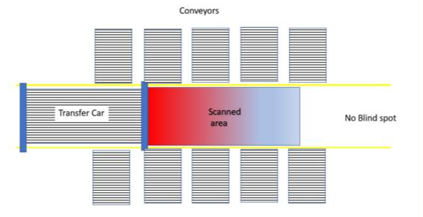
Prevent contact with the transfer car - TC 11
Proximity Lasers
When setting up the scanners they need to be adjusted (mapped) in a way that there are no blind spots and a person standing or lying in the transfer car lane or on the edge of the conveyor is detected and the transfer car comes to a complete stop before contact is made.
Therefore, it is necessary to optimally adapt the geometry of the protective field to the existing conveyor dimensions.

Slide 17
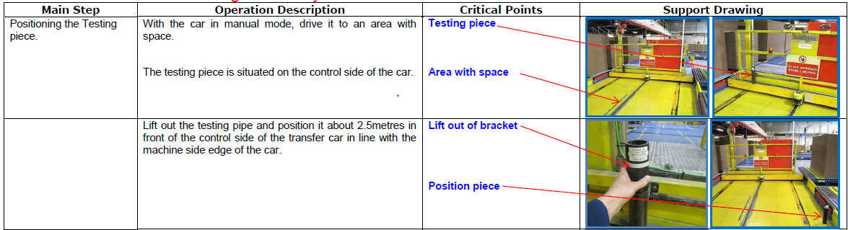
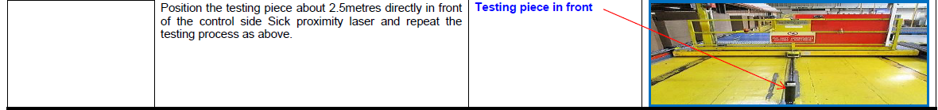
4. Prevent contact with the transfer car - TC 12
Testing Proximity Lasers (Example)

Slide 18
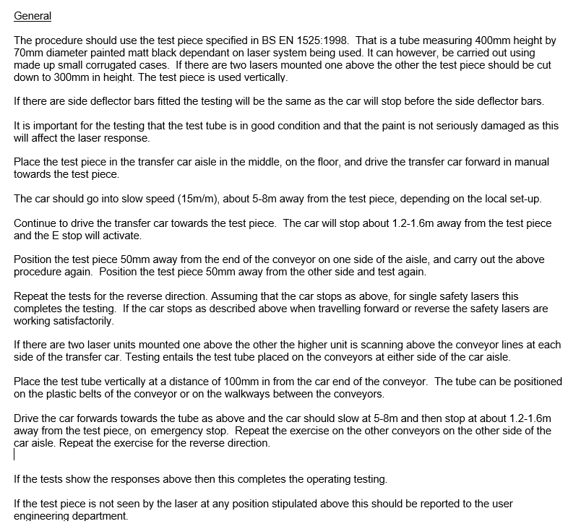
Original Operator check instructions for checking the operation of transfer car safety lasers
General
The procedure should use the test piece specified in BS EN 1525:1998. That is a tube measuring 400mm height by 70mm diameter painted matt black dependant on laser system being used. It can however, be carried out using made up small corrugated cases. If there are two lasers mounted one above the other the test piece should be cut down to 300mm in height. The test piece is used vertically.
If there are side deflector bars fitted the testing will be the same as the car will stop before the side deflector bars.
It is important for the testing that the test tube is in good condition and that the paint is not seriously damaged as this will affect the laser response.
Place the test piece in the transfer car aisle in the middle, on the floor, and drive the transfer car forward in manual towards the test piece.
The car should go into slow speed (15m/m), about 5-8m away from the test piece, depending on the local set-up.
Continue to drive the transfer car towards the test piece. The car will stop about 1.2-1.6m away from the test piece and the E stop will activate.
Position the test piece 50mm away from the end of the conveyor on one side of the aisle, and carry out the above procedure again. Position the test piece 50mm away from the other side and test again.
Repeat the tests for the reverse direction. Assuming that the car stops as above, for single safety lasers this completes the testing. If the car stops as described above when travelling forward or reverse the safety lasers are working satisfactorily.
If there are two laser units mounted one above the other the higher unit is scanning above the conveyor lines at each side of the transfer car. Testing entails the test tube placed on the conveyors at either side of the car aisle.
Place the test tube vertically at a distance of 100mm in from the car end of the conveyor. The tube can be positioned on the plastic belts of the conveyor or on the walkways between the conveyors.
Drive the car forwards towards the tube as above and the car should slow at 5-8m and then stop at about 1.2-1.6m away from the test piece, on emergency stop. Repeat the exercise on the other conveyors on the other side of the car aisle. Repeat the exercise for the reverse direction.
If the tests show the responses above then this completes the operating testing.
If the test piece is not seen by the laser at any position stipulated above this should be reported to the user engineering department.
The results of the tests should be recorded on a control sheet such as the one below.
Prevent contact with the transfer car - TC 13
Testing Proximity Lasers (Example)

Slide 19
Prevent contact with the transfer car - TC 14
Testing Proximity Lasers (Example)
The results of the tests should be recorded on a control sheet such as the one below.
Example control sheet.
Date test carried out | Laser unit | Tests OK Y/N | Comments | Signature
 | Lower forward
 | Lower reverse
 | Upper forward
 | Upper Reverse

Slide 20
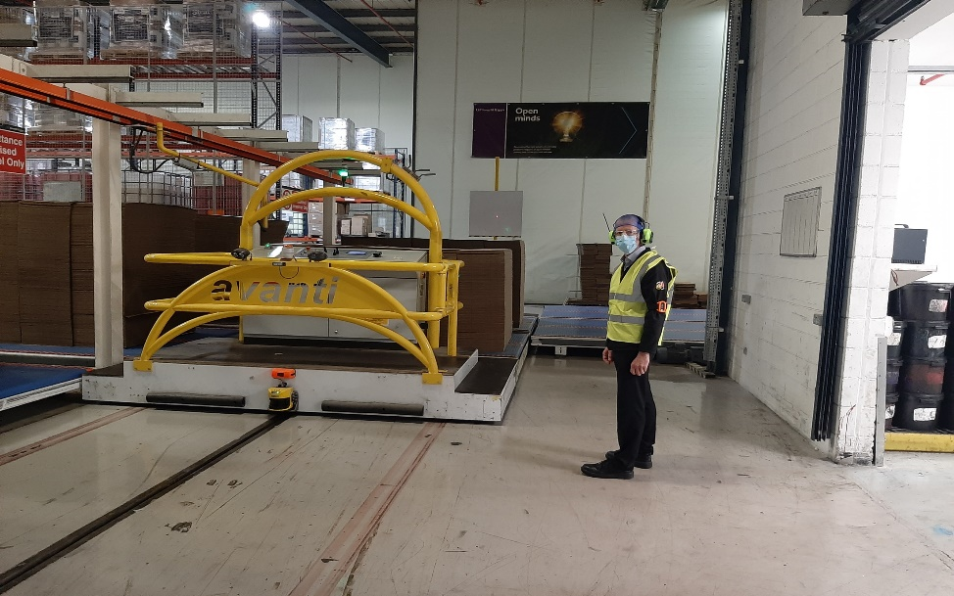
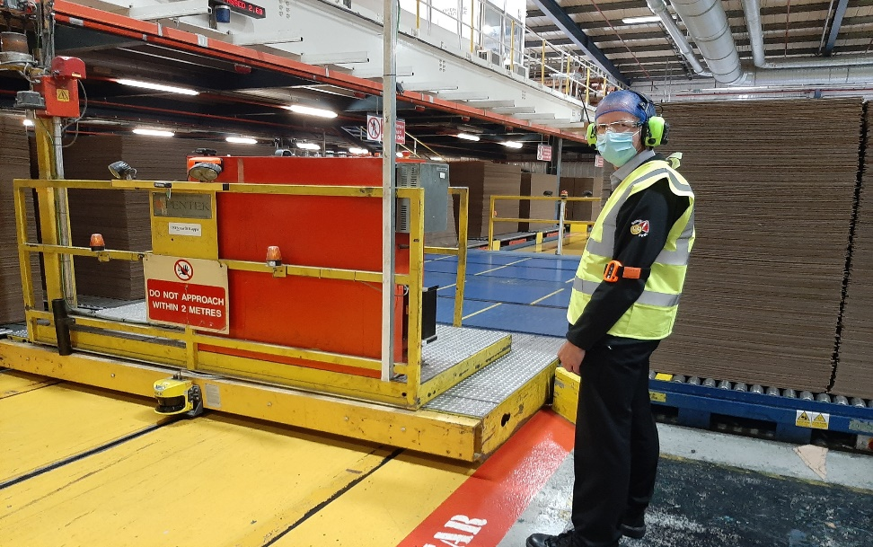
Prevent contact with the transfer car – TC 15
Proximity Alert System
Accident and collision prevention system
Utilising the latest ultra wideband (UWB) technology.
Setting proximity zones around the transfer car allowing for the detection of people with the ability to give warning to pedestrians, slow the car down or stop the car.
Tag and Sensors

Slide 21
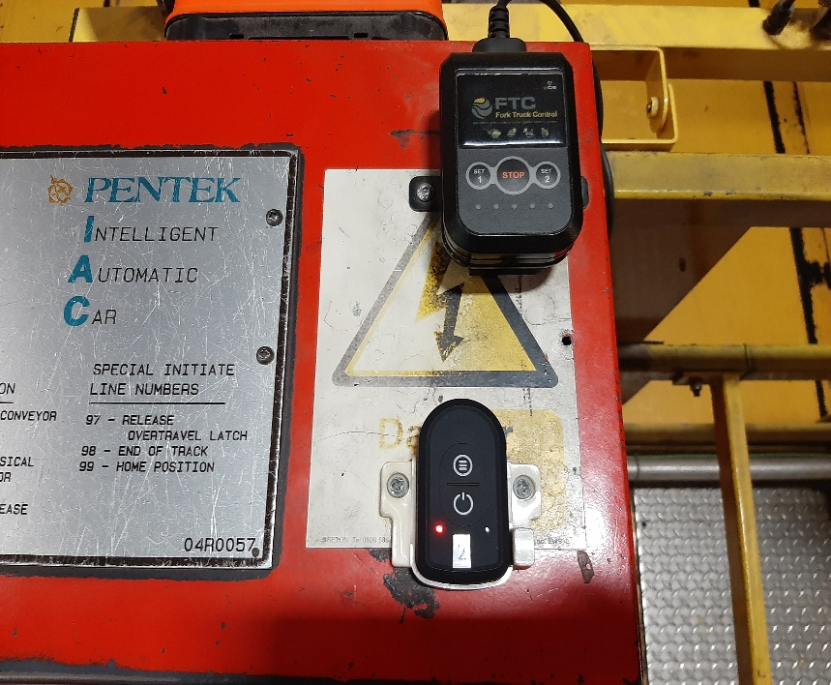
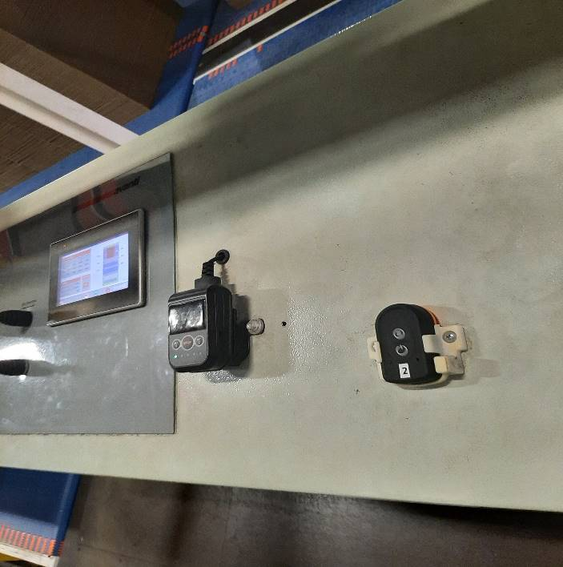
4. Prevent contact with the transfer car – TC 16
Proximity Alert System Example
2 UWB Antenna – located at the front and rear of the transfer car enabling a complete detection zone within figure of 8 zone pattern.
1 display unit on the transfer car.
2 Detection zones - Zone 1 alert zone (warning) Zone 2 danger zone.
Tag and Control Box

Slide 22
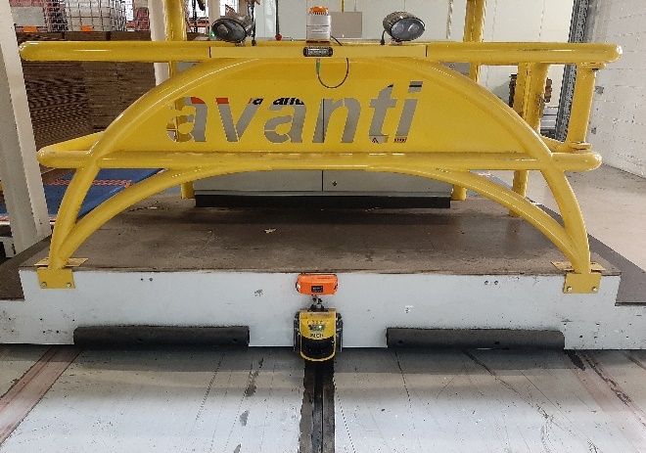
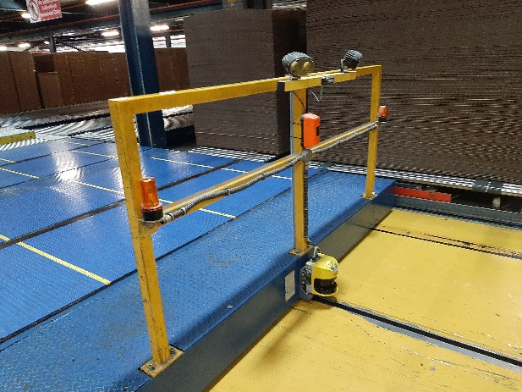
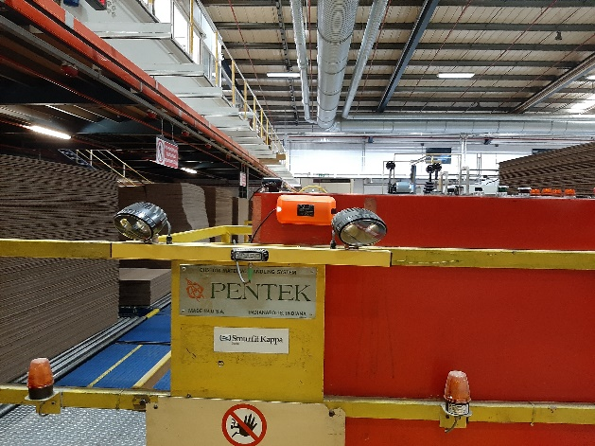
Prevent contact with the transfer car – TC 17
Proximity Alert System
Sensor Location - Examples

Slide 23
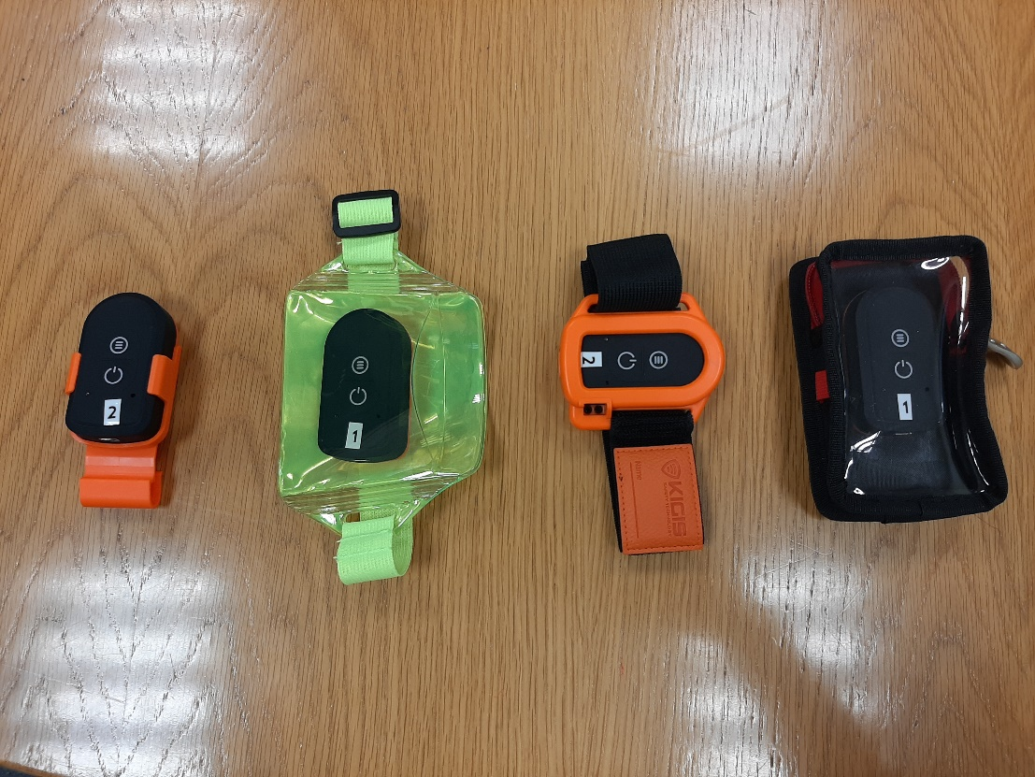
Prevent contact with the transfer car – TC 18
Proximity Alert System
Tag Holder Options

Slide 24
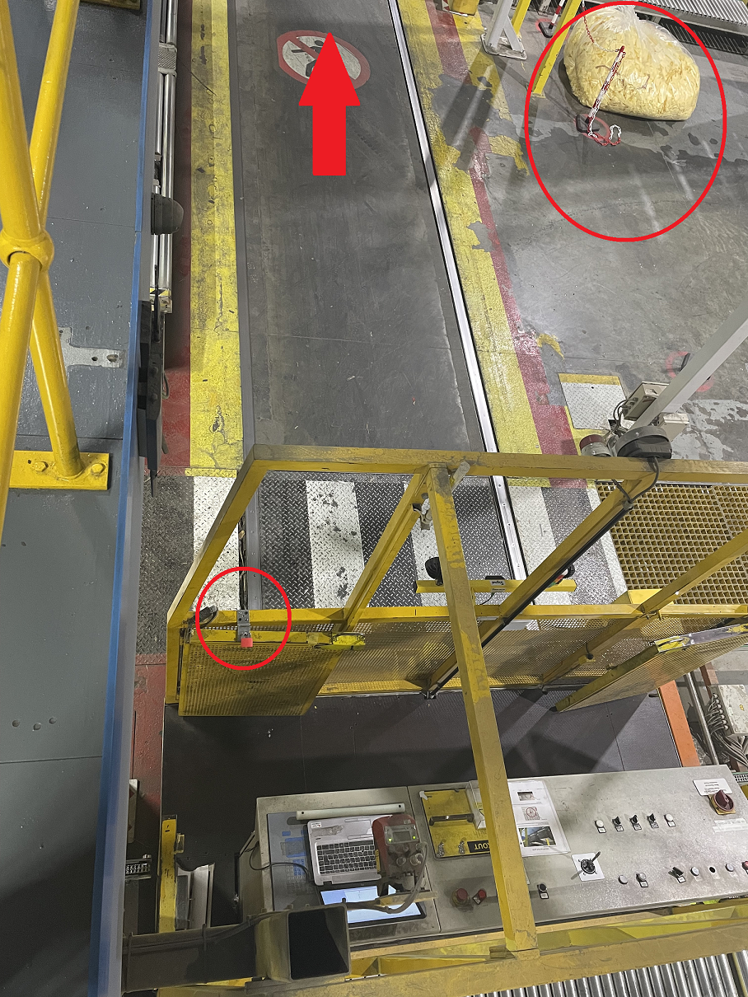
Reduce the risk – TC 19
Control access to the transfer car lane
Where practical, access to the transfer car lane should be prohibited at all times. For any routine tasks ( moving materials to machines etc) or non routine tasks
(engineering/ maintenance work including work on conveyors). LOTOTO must be applied and the transfer car MUST be locked-off to prevent any movement. A PtW must also be issued. Reliance purely on a proximity alert system is NOT acceptable in these situations.

Slide 25
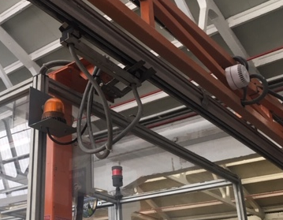
Reduce the risk - TC 20
Sound and Visual Warning
Each transfer car shall have visual and acoustic machine condition indicators.
Prior to a transfer car setting off, a 6 second pulsed audible alarm should be automatically activated.

Slide 26
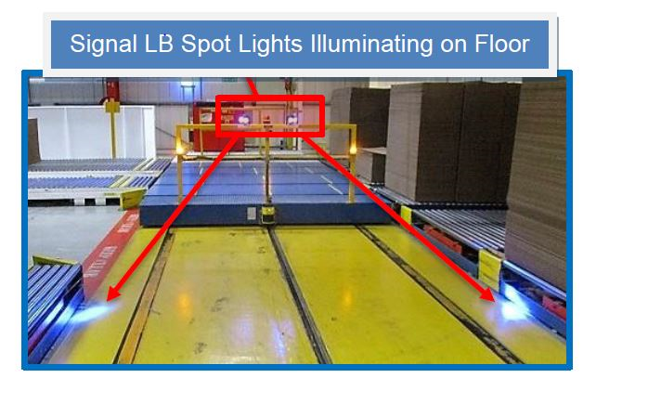
Reduce the risk - TC 21
Sound and Visual Warning
Visual warning solution for automatic transfer car systems which operates in the direction of travel when the transfer car is moving.

Slide 27
Reduce the risk - TC 22
Sound and Visual Warning
The visual indicators shall use the following colours to indicate the transfer car condition
Visual Indicator - Colour | Meaning | Action by operator
Red flashing | Hazardous condition (E stop) | Immediate action to deal with the hazardous condition
Yellow flashing | Transfer car in transit
Blue flashing | Safety function activated | Mandatory safety related control system. Reset required
Green | Transfer car stationary in automatic mode
White | Transfer car in manual mode
The acoustic signals shall use the following tones to indicate the transfer car condition
Acoustic signal | Meaning | Action by operator
Continuous tone | Hazardous condition (E stop) | Immediate action to deal with the hazardous condition
Six second duration pulsed tone | Transfer car about to move
Pulsed tone | Transfer car in transit
No tone | Safety function activated | Mandatory safety related control system. Reset required

Slide 28
Reduce the risk - TC 23
Crossing Points
Where it is necessary for pedestrians to cross a transfer car lane / route, it is recommended to have defined crossing points along the route.
Crossing point methods should consider the hierarchy of controls based on the risk.
The following are four examples that could be adopted.

Slide 29
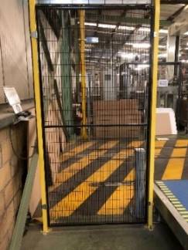
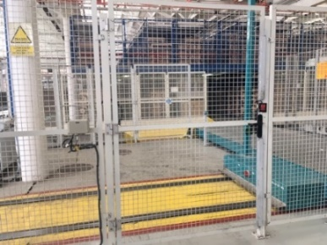
Reduce the risk - TC 24
Crossing points – Hierarchy Example 1
Access Request Gates - Request to entry system
Guard locking switches can be used which will lock the access gate closed until the transfer car is stationery and in a safe location.
The transfer car will not move until the access gate is closed and locked.

Slide 30
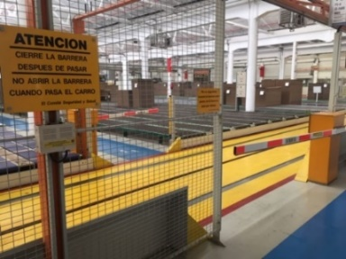
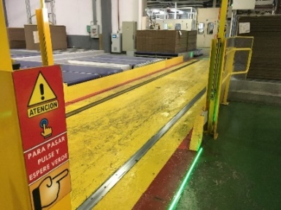
Reduce the risk - TC 25
Crossing points – Hierarchy Example 2
Barriers with passing request - They open depending on the position of the transfer car and have ability to ‘park’ the car to allow safe crossing.
Depending on the position of the transfer car, the system indicates a status colour. In order to cross, you must request the passage and await a safe signal to progress.

Slide 31

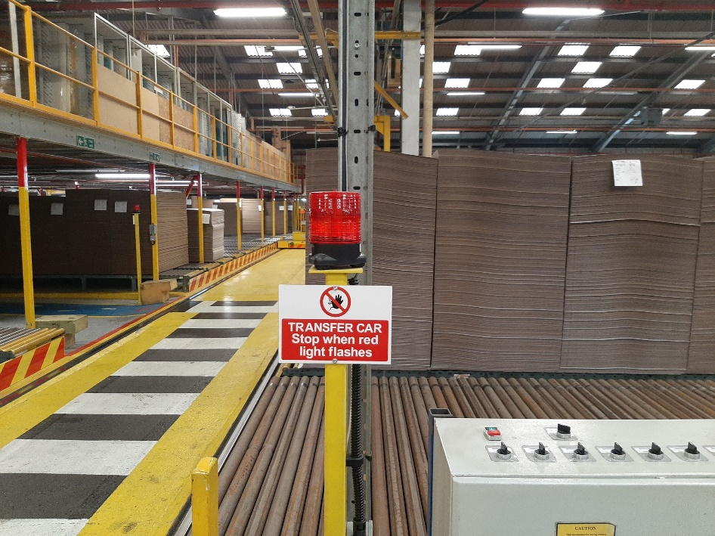
Reduce the risk - TC 26
Crossing points – Hierarchy Example - 3
Crossing point status indicators - Light system (traffic light) linked to the transfer car position. Indicates if safe to cross or not.

Slide 32
Reduce the risk - TC 27
Crossing points – Hierarchy Example 4
Barrier crossing – A push button is required to open the barrier. If the transfer car is in the crossing zone, the barrier is inhibited until it is safe to cross.
Chicane barriers which warns the person they are about to cross a transfer car lane.

Slide 33
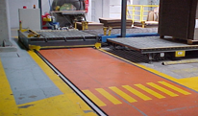
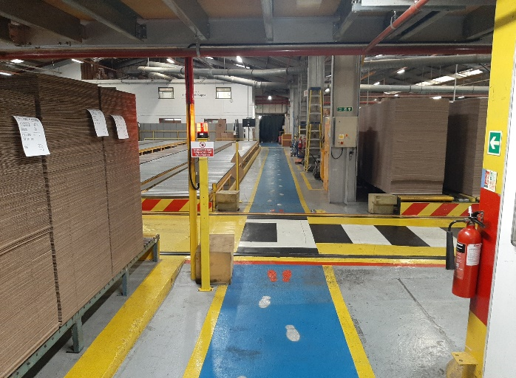
Reduce the risk - TC 28
Crossing points – Hierarchy Example - 5
Reduce as much as possible the number of crossing points of pedestrian ways through transfer car route / path.
The transfer routes can only be crossed at the authorised crossing points by pedestrians.
They must be clearly marked and with the necessary protective measures in place
If there are crush points that can’t be sufficiently protected, safe crossing system mandatory to neutralize the hazard.

Slide 34
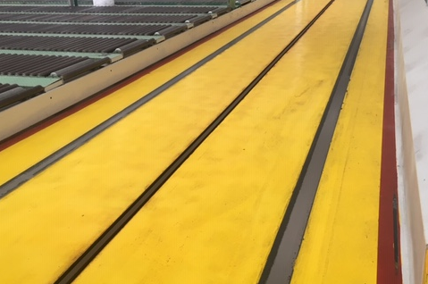
Reduce the risk - TC 29
Identification of the transfer car route
The transfer routes should be painted in such a way that both the transfer route and the possible crossing points that exist will be easily identifiable.
Keep Clear - Red Safe Zone

Slide 35
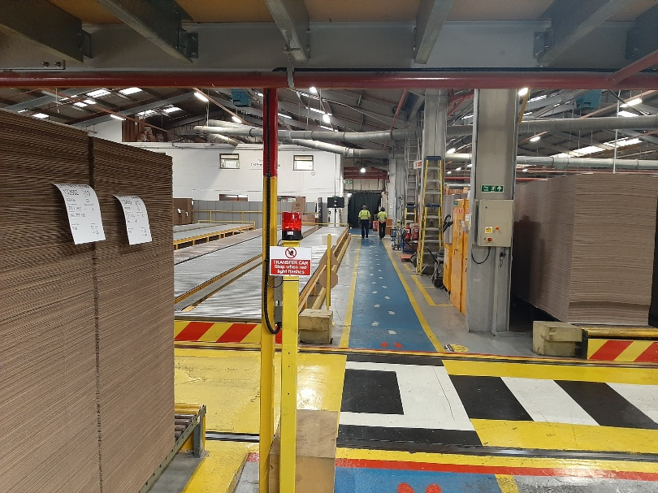
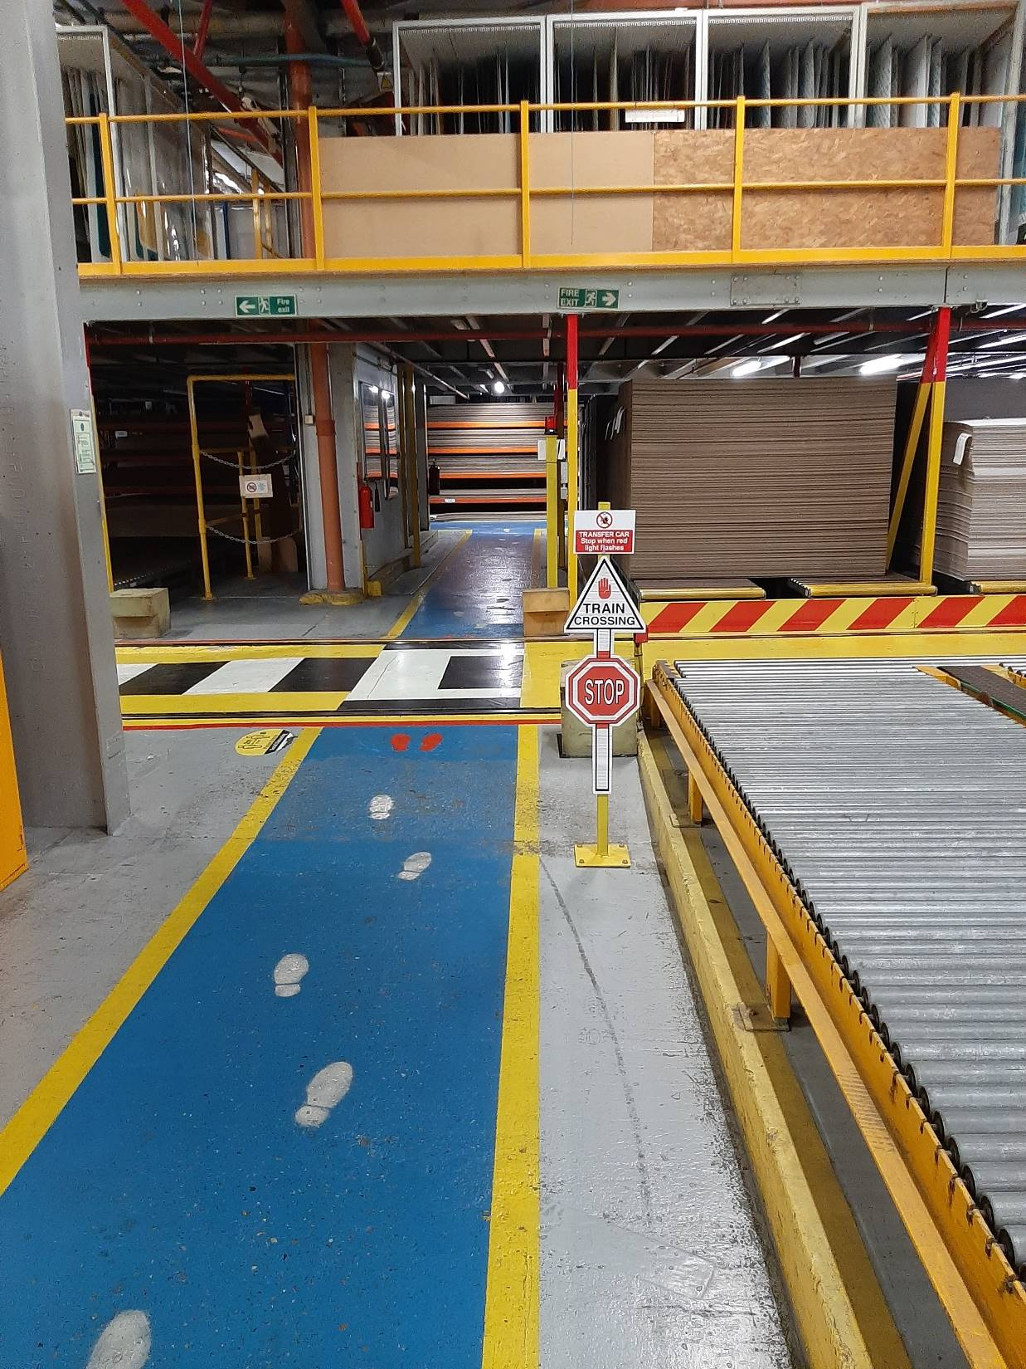
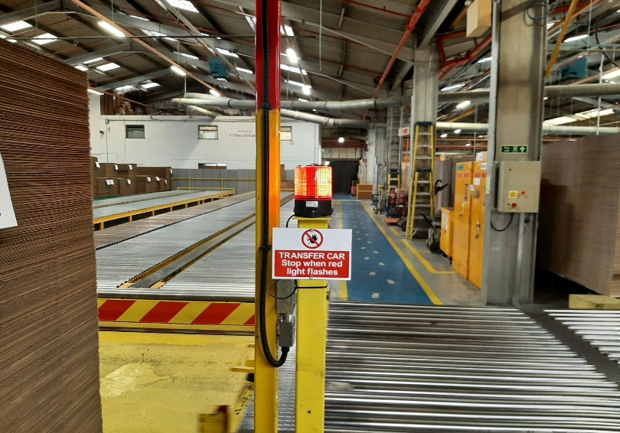
Reduce the risk - TC 30
Floor markings / signage

Slide 36
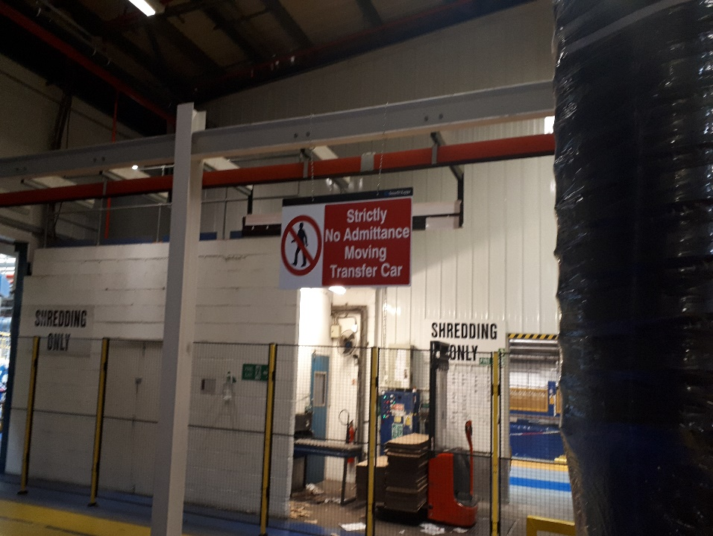
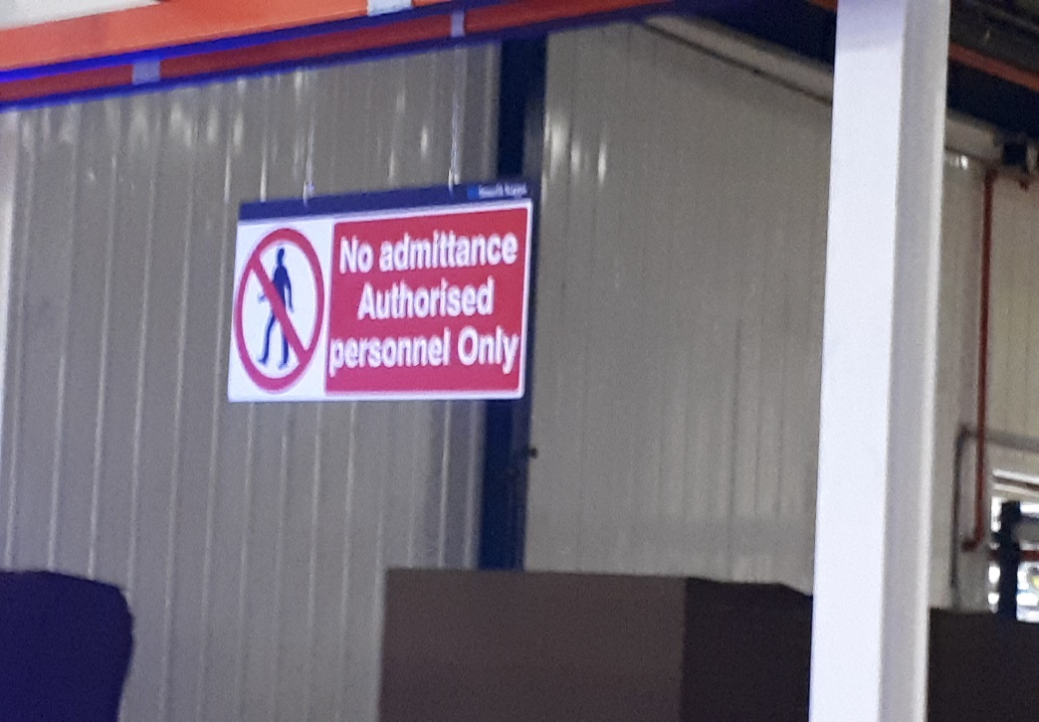
Reduce the risk - TC 31
Warning Signage

Slide 37
Prevent contact with hazard - TC 32
Conveyor Layout
Conveyor systems are used extensively in the industry to feed material units on and off transfer cars, and there is a danger that people can be crushed and shearing risks for persons standing between the conveyor and the transfer car.
In order to avoid a foot or body entanglement hazard between transfer car structure and other conveyor structures or the corrugated stacks on the storage area/conveyors, entrapment points must be eliminated, and minimum distances must be kept

Slide 38
Prevent contact with hazard - TC 33
Raise the floor area
Raise all floor areas to the same level as the conveyor and transfer car by installing working platforms.
If there are protective structures along the route, prevent access to the route.
The distance should be >500 mm (distance to escape).
If there is an opening, the platform should be >1000 mm wide.

Slide 39
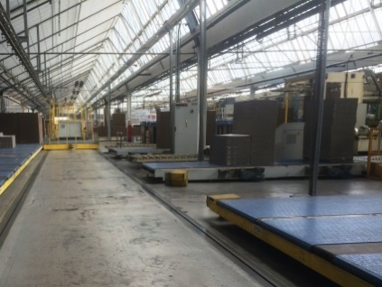
Prevent contact with hazard - TC 34
Conveyor Layout
Conveyors spread - There are free spaces between conveyors, therefore there may be many potential crushing and shearing risks.
It is strongly recommended to reduce the number of open spaces between conveyors as much as possible.

Slide 40
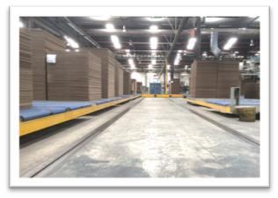
Reduce the risk - TC 35
Conveyor Layout
Front ended not fully covered
Allowing a distance of at least 150 mm from the conveyor edge to enable a trouble-free scanning of the area underneath the conveyor.

Slide 41
Prevent contact with hazard - TC 36
Elimination of conveyor entrapment points
Continuous side plate at the same height where possible as the conveyor is the most simple solution to eliminate crush points with transfer cars.

Slide 42
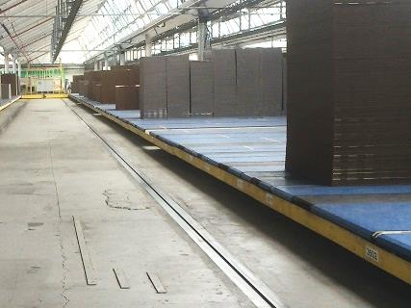
Prevent contact with hazard - TC 37
Elimination of conveyor entrapment points
Only the starting and finishing point are open ended, the rest of the conveyors are joined together.
With this configuration, the crushing and shearing risks are minimised.

Slide 43
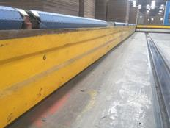
Prevent contact with hazard - TC 38
Elimination of conveyor entrapment points
Front ended covering of the roller conveyor
Where there is a combination of conveyors in the same transfer car route, it may not be possible to allow a distance beneath them of 150 mm.
Conveyors are completely covered to avoid trapping points. The gap between the fixed plate and the conveyor should not be greater than 5mm.

Slide 44
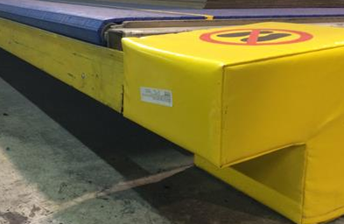
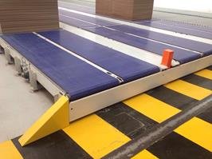
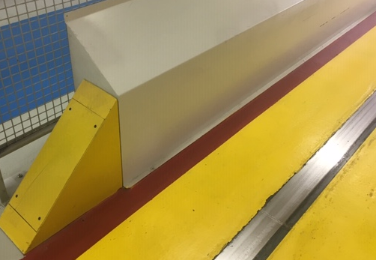
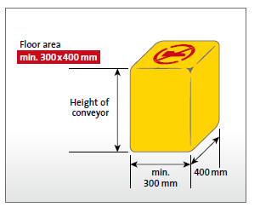
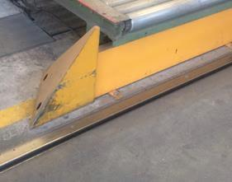
Reduce the risk - TC 39
Minimising conveyor shearing points
Ensure foam pads or metal plates are fitted on both sides of every conveyor leading to the transfer car route. These are designed to push any objects away from the car and to minimise entrapment risk.

Slide 45
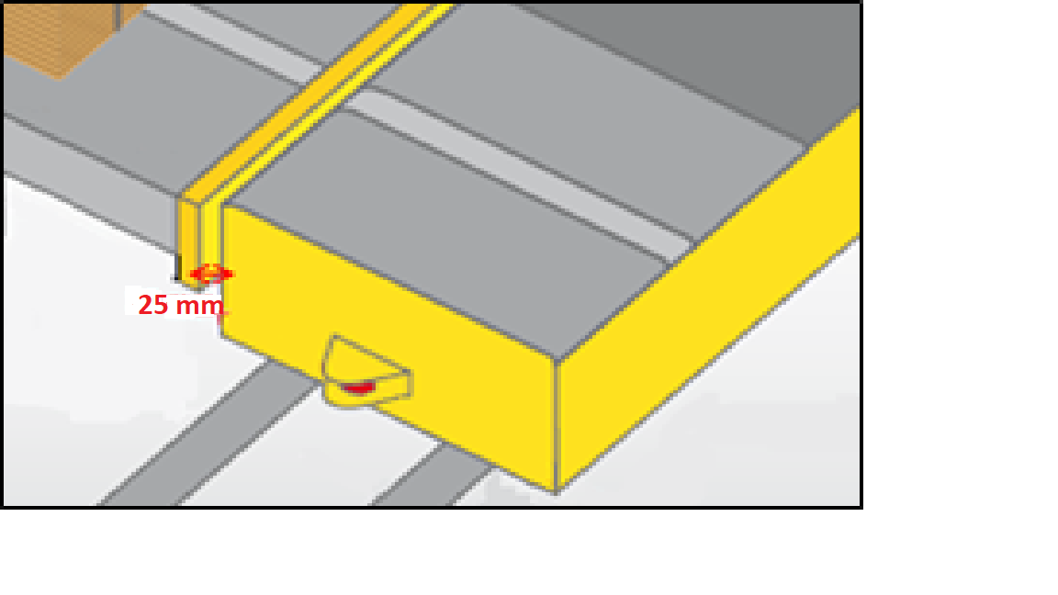
Reduce the risk - TC 34
Safe distances and minimum gaps
In order to avoid an entanglement hazard between foot and transfer car, the transfer car has to be covered laterally in a manner that the distance to the floor does not exceed 25 mm. If this is not possible a distance of at least 120 mm has to be kept.
Please refer to BS EN 349 ISO 13854:2017 (Minimum gaps to avoid crushing to parts of the human bodies).

Slide 46

Reduce the risk - TC 40
Safe distances and minimum gaps
The maximum distance between transfer car and lateral front covers of the conveyors has to be no greater than 25 mm. A space as small as possible should be aimed for in order to avoid a crushing of body parts in this area. Please refer to ISO 13854:2017 (Minimum gaps to avoid crushing to parts of the human bodies).
.
25MM
<->

Slide 47

Reduce the risk - TC 41
Safe distances and minimum gaps
A distance of at least 500 mm for body height between transfer car and fixed elements such as building stanchions. If this is not possible, a risk assessment has to be done to define safety counter measures.
180 mm between structures if the structure at leg height.
Please refer to ISO 13854:2017 (Minimum gaps to avoid crushing to parts of the human bodies).

Slide 48


Reduce the risk - TC 42
Safe distances and minimum gaps
In all the scenarios, it is strongly recommended lining the spaces between the conveyors by filling the spaces with horizontal plates.
These should be installed at the same height level of the conveyor and should be set out at a length of at least 1m like a platform in order to avoid additional tripping points.

Slide 49

Other general control measures - TC 43
Automatic / Manual Operating Modes
Operation modes - There is likely to be only two operating modes available on the TC:
Automatic operation mode
Manual operation mode
If the transfer car has been designed and constructed to allow it to operate in both modes, each mode will require protective safety control measures and a clear SSoW
All control devices must be clearly identifiable and must correspond to a single operating or control mode.
Operators and maintenance personnel will need to be competent in the use and different operating functions for both modes.
Ensure there are local safe systems of work in place which include safe access and
egress and switching the car from automatic to manual mode and vice versa.

Slide 50
Other general control measures - TC 44
Access and egress safely
Ascend & descend in a Safe manner
Hold barrier & gain good balance when
operating the transfer car manually.
Only access and egress the transfer car when it is stationery / parked up.
Ensure there are local safe systems of work in place which include safe access and
egress.

Slide 51

Other general control measures - TC 45
Energy Isolation – Lock out, Tag out, Try out.
It is critical that energy isolation (lock out tag out try out) has been applied prior to any non routine intervention which includes engineering / maintenance / cleaning tasks on the transfer car and associated conveyor systems.
This includes all energy sources (electric, pneumatic) on the transfer car and conveyor systems.
Local safe system of work and energy isolation procedure must be in place.
A system needs to be in place for monitoring compliance with all LOTOTO procedures.

Slide 52



Other general control measures - TC 46
Preventing Slips, trips and falls
Information
HSE website
Tools to use

Slide 53

Contact Point
Appendices
Transfer Car Incident
What Happened
Operator went to assist two colleagues sort out an out of line stack.
It is likely he had his right foot on the roller and left foot on the floor
TC was behind him and he did not hear or see the car movement
The scanner did not pick him up
The car struck him and kept moving
Direction of Car

Slide 54

Appendices
Transfer Car Incident
What Happened
Curve would have pulled his leg in – rather than push it away
He was dragged 4m before the car was stopped.
He colleagues freed him
He was badly injured
His colleagues attached a tourniquet to halt the bleeding.
Emergency services arrived and took him to hospital.
His lost his left leg below the knee

